Slide 1


Reducing Commercial Aviation Fatalities
Can you tell when a pilot is heading for trouble?

Slide 2

Reducing Commercial Aviation Fatalities
Aircraft accident statistics can prove a valuable source of information that allows for the setting of priorities and the monitoring of progress made by the aeronautic industry. They are being calculated for many kinds of aircraft.
The statistics presented in this section include worldwide commercial jet planes with a maximum gross weight of over 60,000 pounds . Airplanes manufactured in the former Soviet Union (CIS) are not included.
Most flight-related fatalities stem from a loss of “airplane state awareness.” That is, ineffective attention management on the part of pilots who may be distracted, sleepy or in other dangerous cognitive states

Slide 3
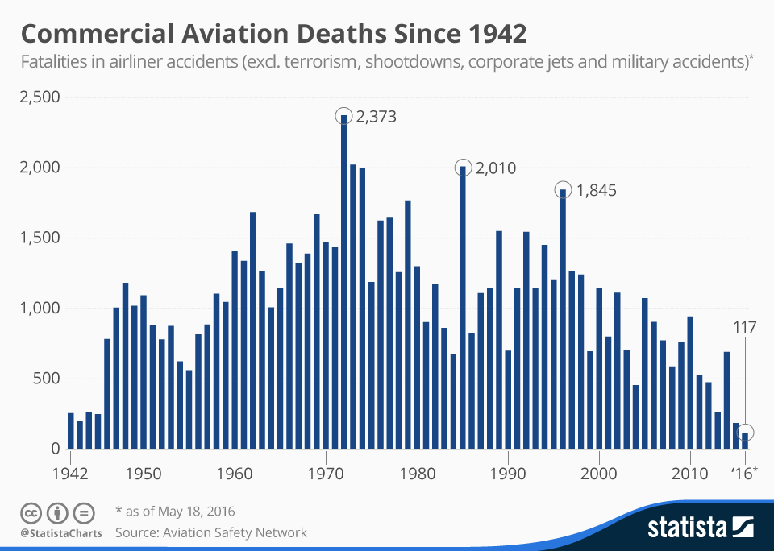
Real life incident story and thier statistics
The number of fatalities in aviation accidents has been trending downwards in recent years thanks to significant safety improvements.
If the EgyptAir crash is confirmed, it will be the second major disaster in 2016 after FlyDubai Flight 981 crashed in Rostov-on-Don, Russia, on March 19, killing all 62 people onboard.
According to data compiled by the Aviation Safety Network, 1972 was the worst year on record for the aviation industy with 2,373 people losing their lives in accidents.

Slide 4

Dataset Descriptions
In this dataset, you are provided with real physiological data from eighteen pilots who were subjected to various distracting events. The benchmark training set is comprised of a set of controlled experiments collected in a non-flight environment, outside of a flight simulator. The test set (abbreviated LOFT = Line Oriented Flight Training) consists of a full flight (take off, flight, and landing) in a flight simulator.

Slide 5

The pilots experienced distractions intended to induce one of the following three cognitive states:
Channelized Attention (CA) is, roughly speaking, the state of being focused on one task to the exclusion of all others. This is induced in benchmarking by having the subjects play an engaging puzzle-based video game.
Diverted Attention (DA) is the state of having one’s attention diverted by actions or thought processes associated with a decision. This is induced by having the subjects perform a display monitoring task. Periodically, a math problem showed up which had to be solved before returning to the monitoring task.
Startle/Surprise (SS) is induced by having the subjects watch movie clips with jump scares.

Slide 6
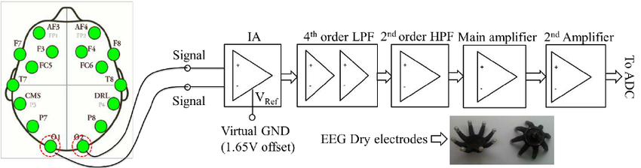
Data fields: Variables with the eeg prefix are electroencephalogram recordings. (EEG is Electroencephalography Sensor data)
Each sensor operated at a sample rate of 256 Hz. Please note that since this is physiological data from real people, there will be noise and artifacts in the data.
For each experiment, a pair of pilots (each with its own crew id) was recorded over time and subjected to the CA, DA, or SS cognitive states. The training set contains three experiments (one for each state) in which the pilots experienced just one of the states. For example, in the experiment = CA, the pilots were either in a baseline state (no event) or the CA state.

